Slide 1
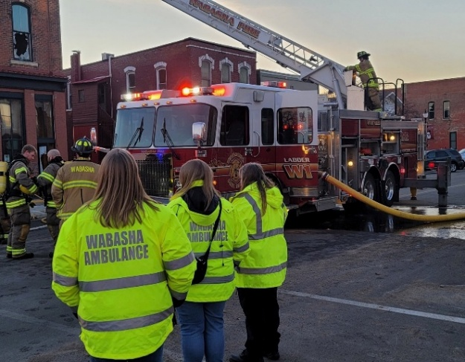
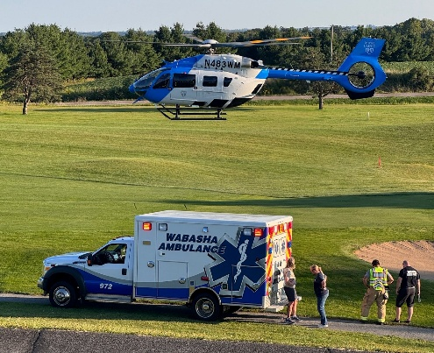
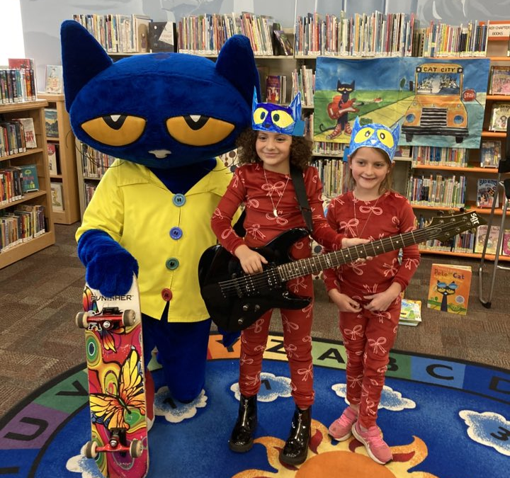
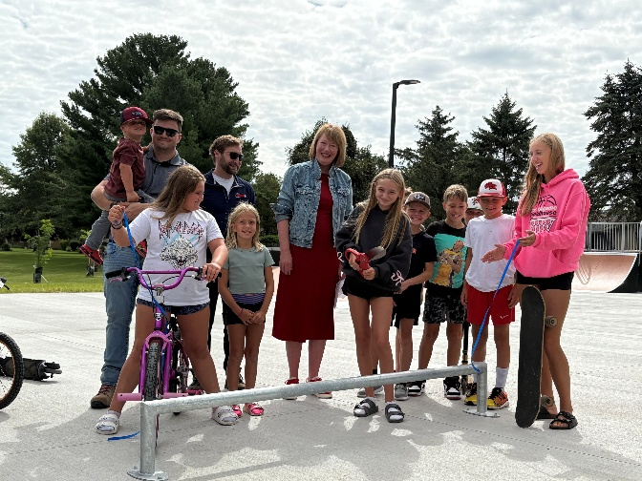
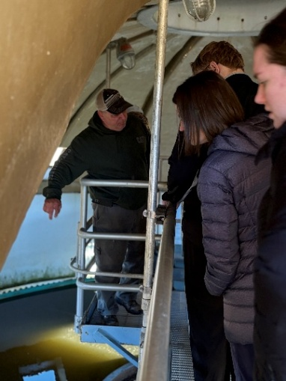
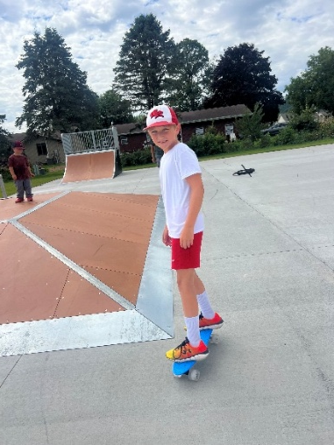
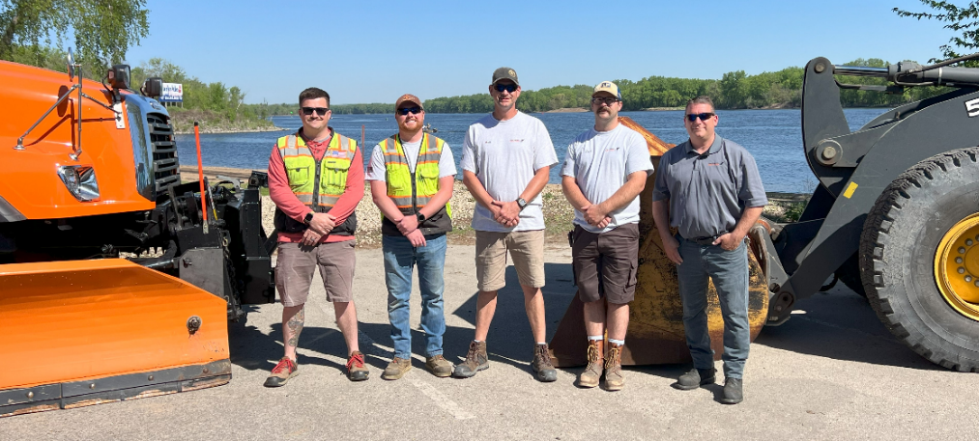
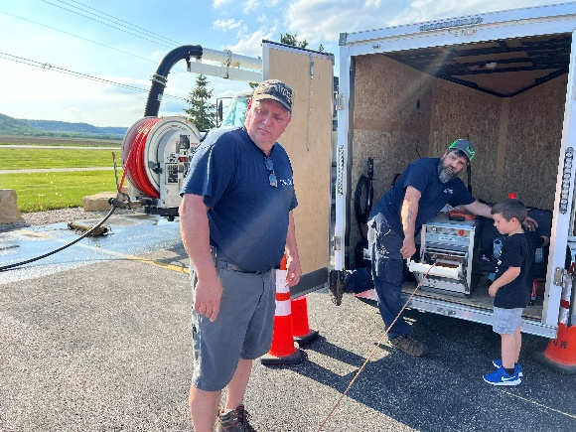
City of Wabasha
2025 Accomplishments
January 6, 2025
6 PM
City Council Meeting

Slide 2
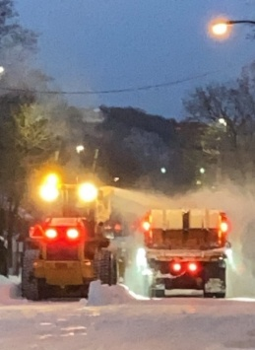
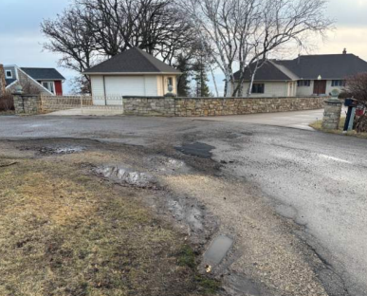
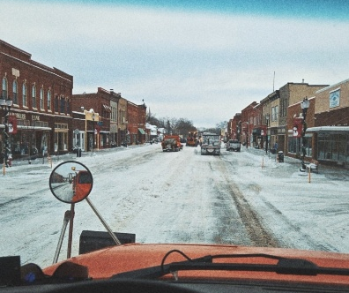
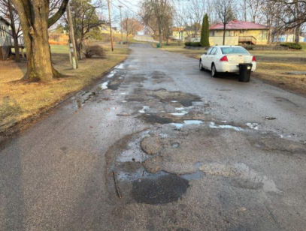
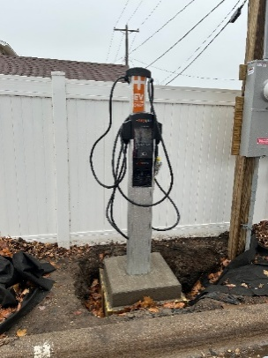

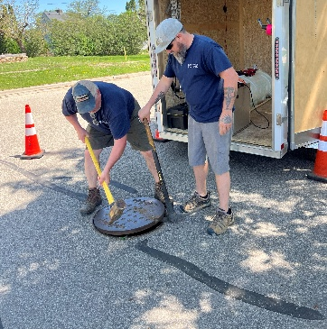

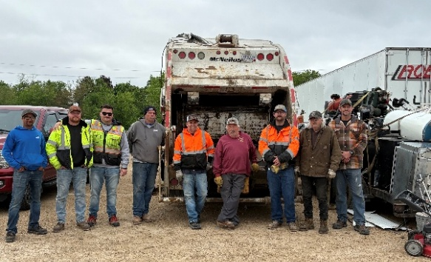
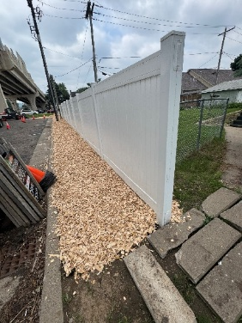
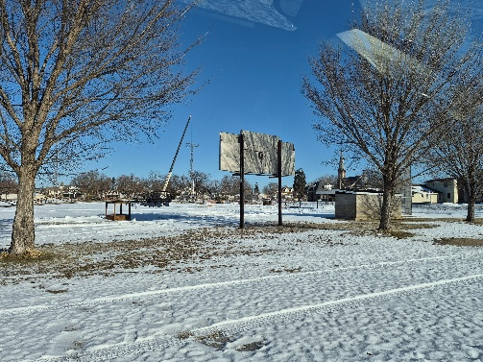
2025 Public Works/Utilities Major Projects
Major street project for most deteriorated streets (Skyline Drive, Buena Vista, 4th street west (maiden), 3rd street west (Shields and Cratte Ave Washington Ave (Market Street and Hiawatha Drive), 11th Street East (Broadway and Pierce)
Completed new patching and surfacing project at 7th Street West, Shields Ave, Campbell Ave, 3rd Street West, City Hall parking lot
Fixed fencing at Heritage Park
Demolition of old athletic field facilities
Added EV Charger and Downtown Wayfinding Signage
Touch a Truck Event, City-Wide Clean Up, High School Wastewater Treatment Plant Tours
Jetting
Wastewater Treatment Plant is in compliance, new requirements
Snow and ice event response
Planted 30 trees

Slide 3
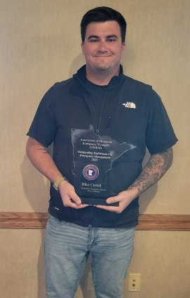
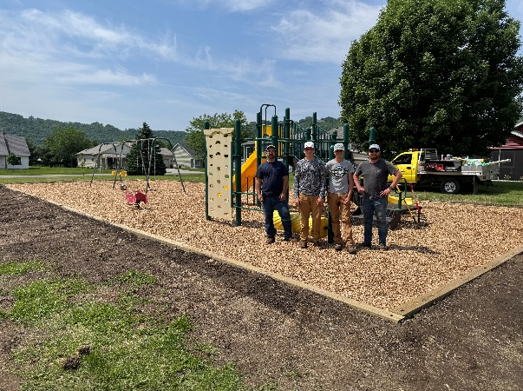
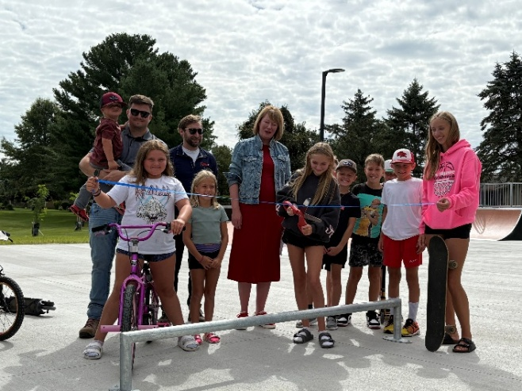
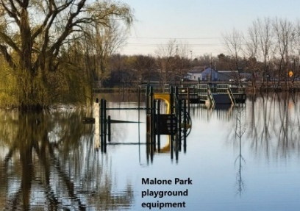
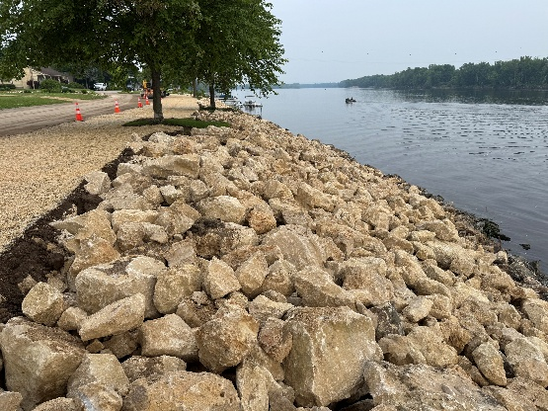
2025 Emergency Management
Added new bike path lighting and fixed path
Relocated new Skate Park
Added rip rap to prevent future erosion along river
Moved Malone playground out of flood zone and moved to Eagles Basin
Riley Costello won Emergency Manager of the Year (Association of Minnesota Emergency Managers (AMEM)
Received $297,956 for flooding mitigation projects

Slide 4
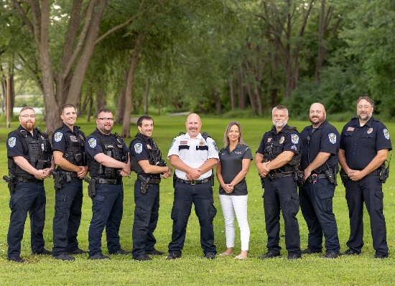
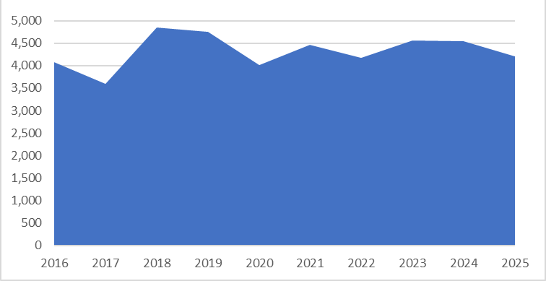
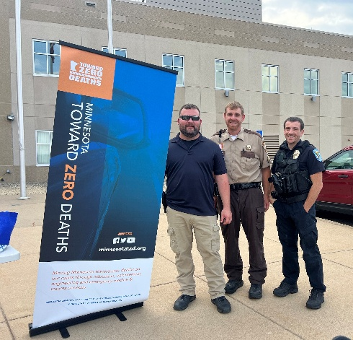
Police Calls for Service
4206 calls for service, 88 misdemeanors, 23 gross misdemeanors, and 68 felonies charged this year.
16 search warrants performed this year- theft, drugs, child pornography, financial exploitation of a vulnerable adults, solicitation of a minor, DWO.

Slide 5

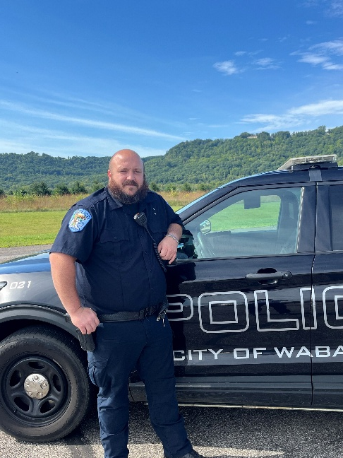
2025 Police Case Spotlights
Secured conviction for a Wabasha man who possessed child sexual abuse materials.
A straightforward workplace theft investigation escalated into a major criminal case, including multiple controlled substances, stolen firearms, and receiving stolen property.
Community tips, overnight surveillance, led to multiple felony drug charges.
Proactive Policing
Community cooperation
Investigative work

Slide 6
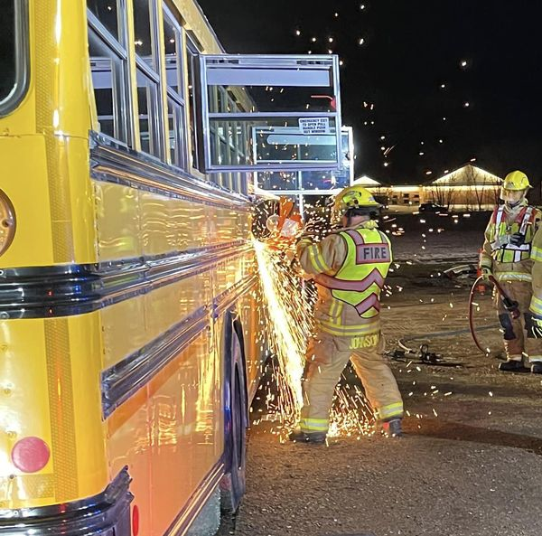
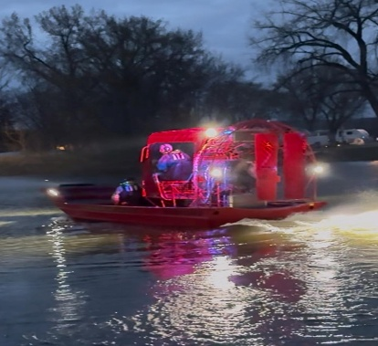
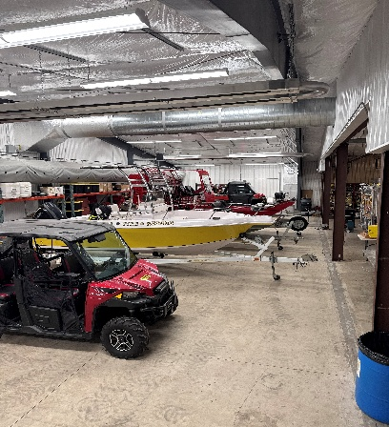
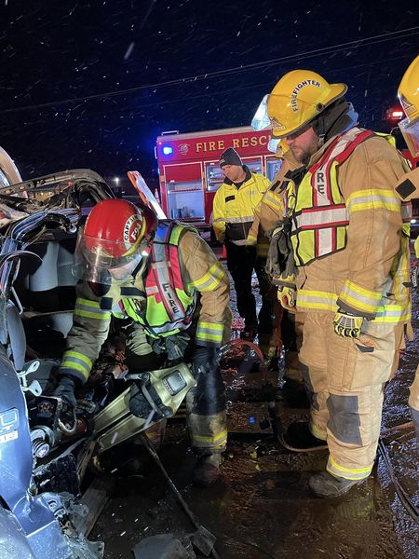
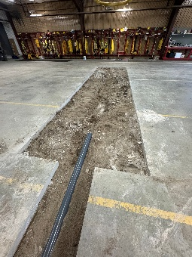
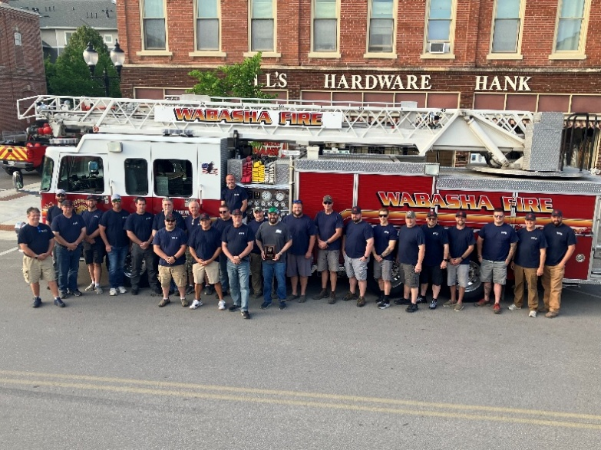
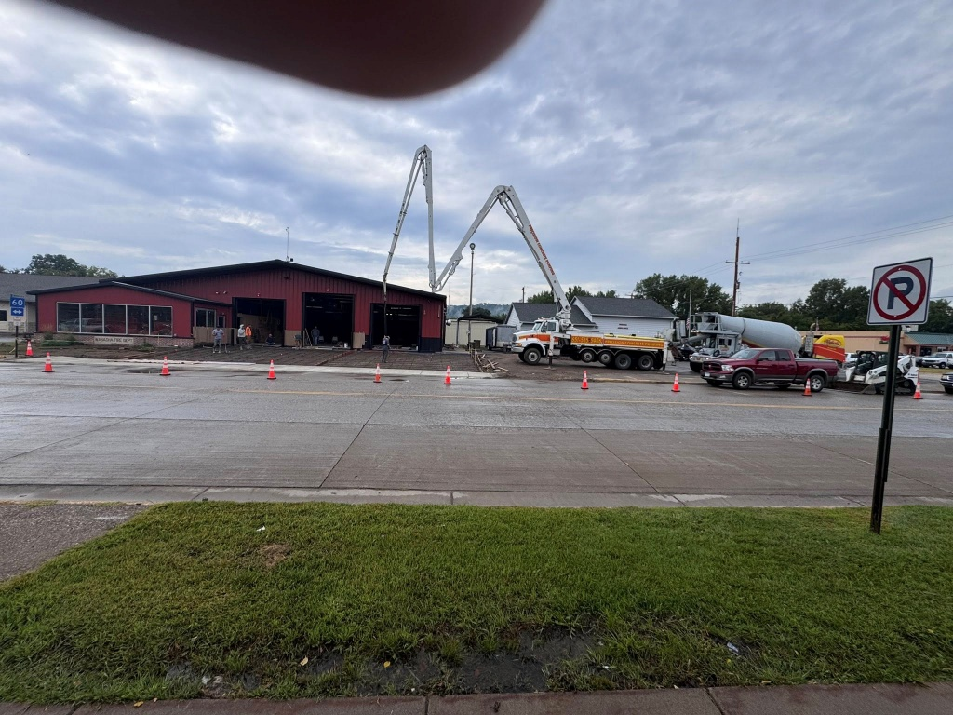
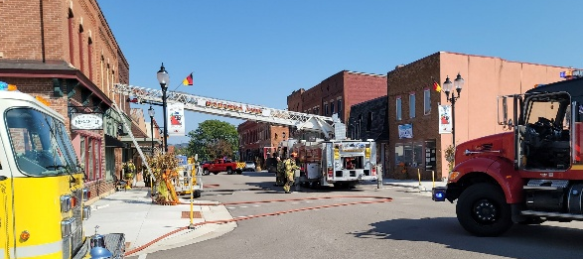
2025 Fire Department
Wabasha Fire had 178 runs (fires, lift assists, power lines, motor vehicle crashes, water rescues). (+58 calls since last year)
Used the air boat 8 times to provide water rescue support
31 volunteers completed 1781 hours of training.
Completed Fire hall addition, installed new concrete apron, upgraded old ventilation system, replaced floor drain
Fundraising provided support for new concrete apron project
Fundraising: Riverboat Days Chicken Feed, raffle tickets for cash prizes, calendar donations, Grumpy Old Men.
48%

Slide 7
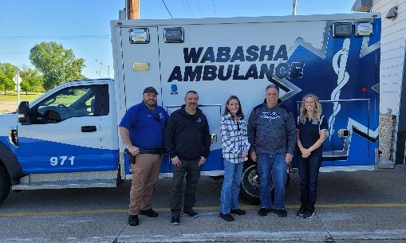
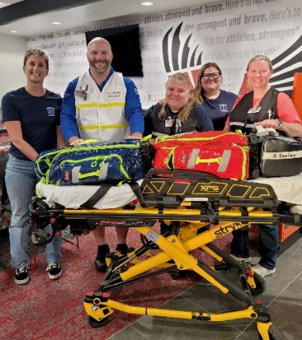
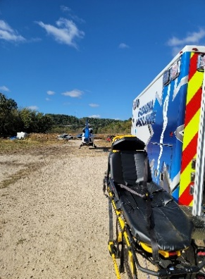
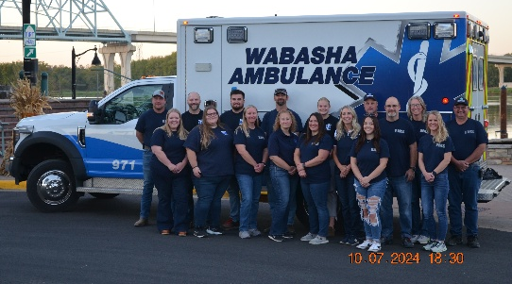
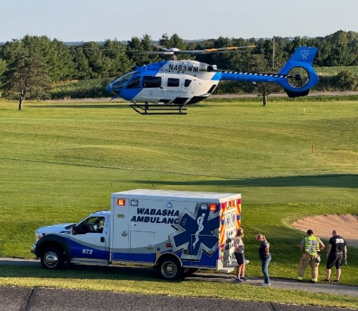
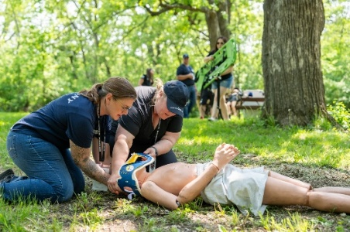
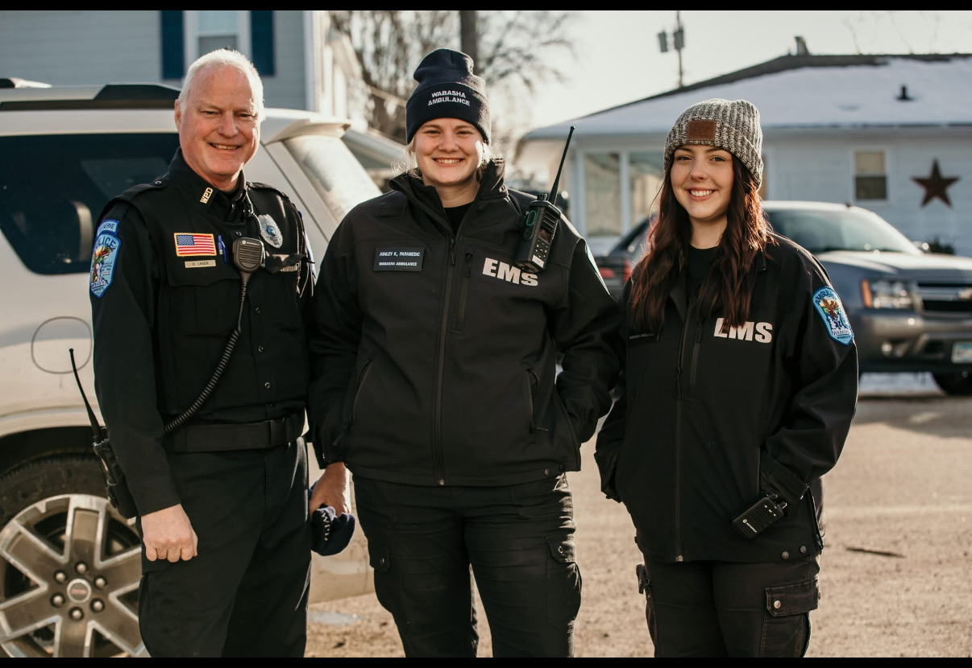
2025 Ambulance
11% calls
Responded to 1,016 calls for service. + 97 calls
Finished with 602 - 911 Calls an increase of 10% over 2024
We took 170 Transfers- an Increase of 43% over 2024
We had 121 Back up Calls (2 calls at the same time) an increase of 78% over 2024
Billing Revenue is up 20% since last year
Exceeded budgeted revenue targets, piloted paramedics in ER with St. Elizabeth’s
15 CPR Classes delivered- 107 people
Delivered EMT course with 4 participants. (One has already passed their test and is working as an EMT for us)
Second full-year of ALS. 186 pre-hospital ALS medications, 54 ALS infusions on transfers.
22 Paid-On Call, 8 full/part-time staff cover 17,520 hours
Our dedicated Crew did 720.75 of training hours
All townships contributed to the ambulance service
20%
revenues

Slide 8
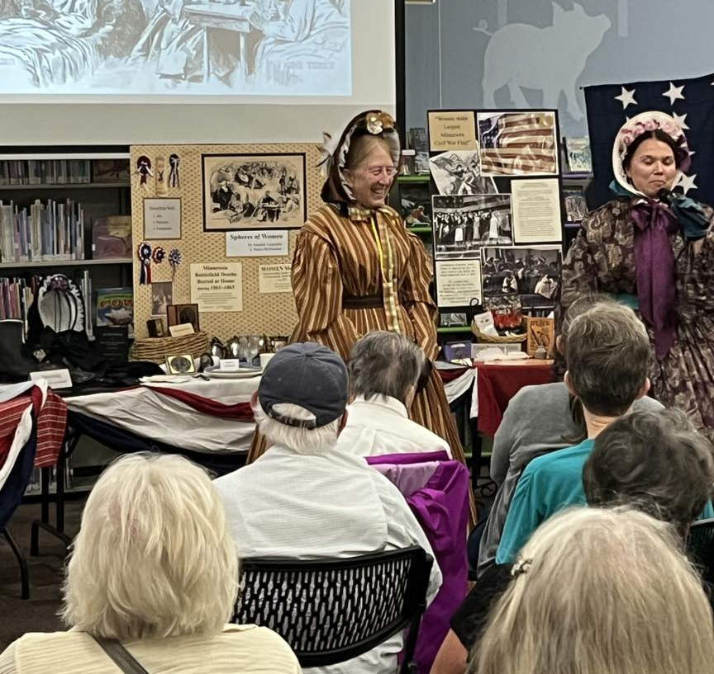
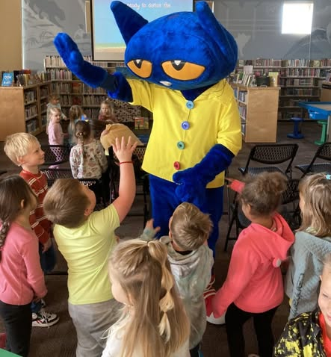
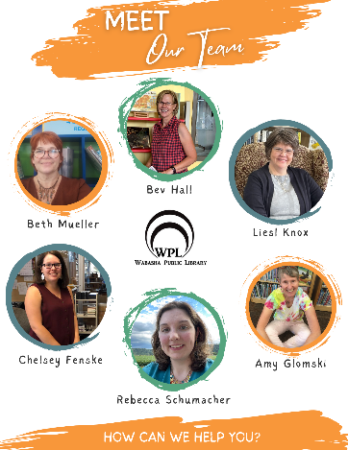

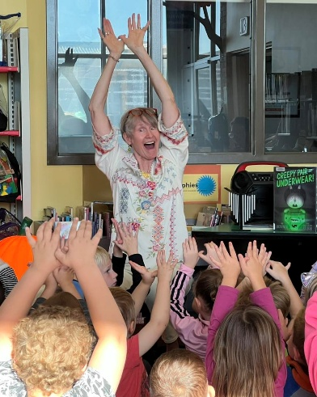
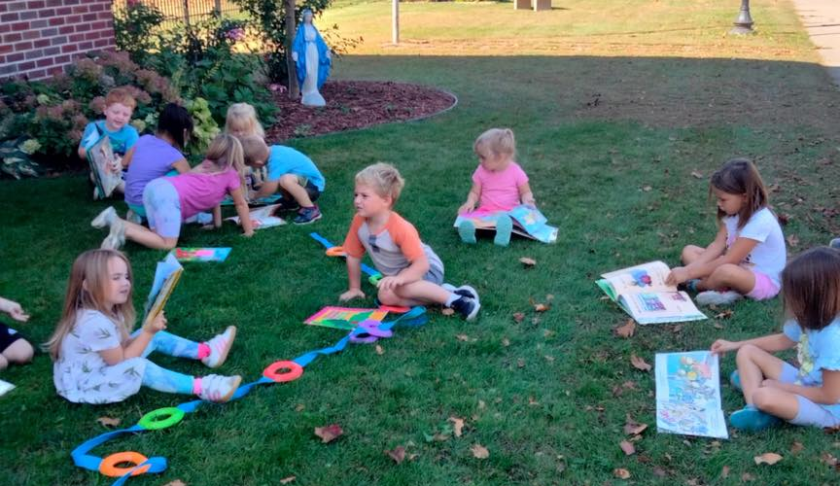
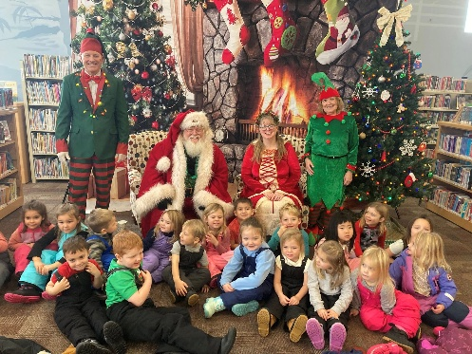
2025 Library
Highlights of the year include: many children and adult programs, started the final mural in the Main Library - "Feathered Horizons"
29,138 visits to the library in 2025
1,035 public computer sessions
3,535 wireless sessions
41,561 physical media circulation and 4,991 ebooks/eaudio
172 programs with attendance of 4,991 for both adults, youth, and children
$12,500 in grants toward programs
13%
Notes:
The Fire Station had quite significant work done this year to add an addition which allowed them to store all of their equipment in one location versus multiple sites throughout the city, replaced a cracked concrete apron, upgraded their hold ventilation system which did not meet code and was a safety hazard, replaced a deteriorating floor drain. We began our 2025 street project which covers Skyline Drive, 3rd street west, Maiden Avenue, 11th street east

Slide 9
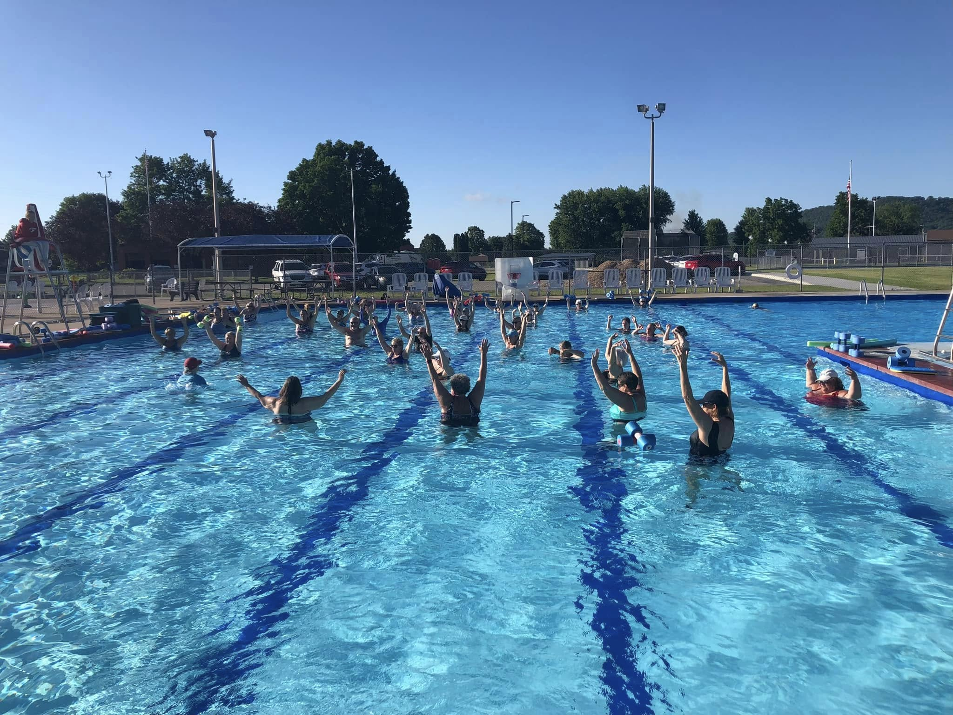
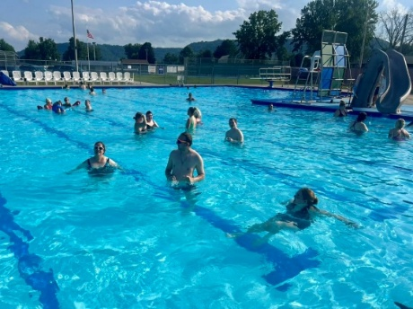
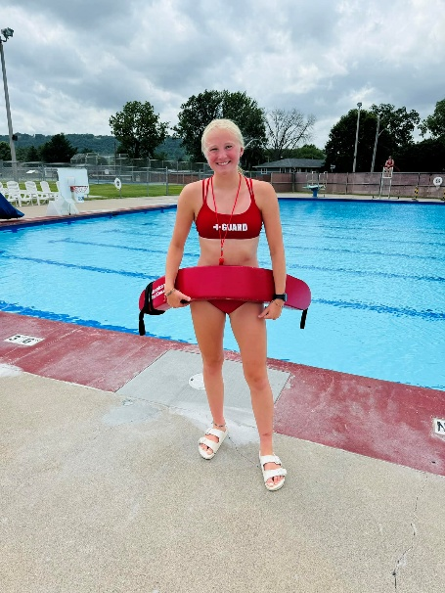

“Our instructor was exceptional with helping our daughter get over her fear of water!”
“No place I would rather spend my Wednesday evenings!” (water aerobics)
2,030 paid visitors, 247 students using the free pass program
Delivered over 273 swim lessons
Water aerobics- more sessions offered, very popular
Recalked pool, repaired leaks, implemented Department of Health Inspection recommendations

Slide 10









2025 City and Port Authority Highlights
Revised Nuisance Code and began work on short term rental regulations
Engaged with the community- two open houses, one online survey, 22 press releases, and highlighted outstanding employees. Facebook widely visited.
Façade Improvement Grant Program distributed over $18,000 in grants to five businesses for improvements to the exterior of their buildings.
Successfully managed $888,304 in federal and state grants. Secured new $750,000 toward new barge terminal road.
Launched Livability website- https://www.wabasha.org/livability/
Port Authority generated $307,423 in net income through Section 217d Army Corps Partnership.
Collected $392,000 in permits, lodging tax, leases, fees.
Received $75,000 contribution from WNB Financial for Athletic Field.
Provided funding to Chamber, Wabasha Main Street, Falcon Youth Baseball, and for bus transit
Engineering work began for Highway 60 Project.

Slide 11





2025 Building Permits Issued
125 flat fee permits (due to storm damages, re-roofs)
29 valuation permits with total valuation of $14,337,000 (W-K renovation)
$1,094,000 (California Overland Truck Wash)
6 new single-family homes permitted, 6 new single-family homes for sale!
Assumes 3% increase in Net Tax Capacity from 2024 to 2025.
Assumes the market value of the home increases 10% from 2024 to 2025.
Notes:
Strong new construction market in the last 5 years with relatively no or few homes built in 2025-2017. Much of this in Eagles Basin and Coulee Way development. California Overland is expanding their business with a commercial truck wash. Significant staff time spent on agreements to ensure that waste generated would not overwhelm our own system. Lots of reroofs this year due to storm damage.

Slide 12





What a year! Thank you Wabasha City Council and Wabasha City Staff.
Thank you to all the City staff on a great year and for your efforts to put together the budget. Thank you to our Wabasha City Council for their support and thoughtful input.

